Slide 1
From Word Embeddings To Document Similarities for
Improved Information Retrieval in Software Engineering
Authors: Xin Ye, Hui Shen, Xiao Ma, Razvan Bunescu, and Chang Liu
Presentation by: Sayantani Goswami

Slide 2
Disadvantages of Traditional Approach
There is a lexical gap between:
A) Search queries, usually expressed in natural language (e.g. English).
B) Retrieved documents, usually expressed in code (e.g. programming languages).
This makes application of information retrieval techniques to search tasks in software engineering difficult.

Slide 3
Proposed Architecture
Word Embedding are:
1. Trained on API documents, tutorials, and reference documents.
2. Aggregated to estimate semantic similarities between documents.
Results:
Learned vector space embeddings lead to improvements in :
1. A previously explored bug localization task.
2. Newly defined task of linking API documents to computer programming questions.

Slide 4
Word Embeddings
Traditional Distributional Semantic Models (DSMs)
Words in the same context tends to have similar meanings
2) Distributional semantic models (DSMs)- (Count based Models)
a) Individual words are not treated as unique symbols.
b) Represented as d-dimensional vectors that capture their contextual meanings.
c) Similar words have similar vector representations.
3) Word-context matrix M,
a) Row corresponds to a word wi,
b) Column cooresponds to a context cj that contains wi
c) Each cell Mij to the co-occurrence counts (e.g. the occurrences of wi in cj).

Slide 5
Neural-network based approaches
NEURAL EMBEDDING/ WORD EMBEDDING
Represent each word with a low dimensional vector
Directly learn the vectors to optimally predict the context (predictive models)
Find vector representation of words (Similar words have similar word embeddings)
Similarity between vectors is defined as cosine similarity.

Slide 6
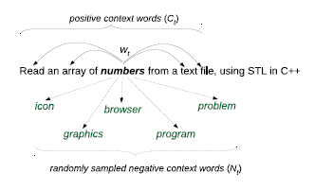
Learning Word Embeddings
Mikolov's Skip-gram model
a) This model significantly outperforms Latent Semantic Analysis (LSA) and other traditional count-based approaches in a set of tasks in IR and NLP.
b) Used to learn embeddings for natural language words and code tokens.
c) Learns vector representations of words that are useful for predicting the surrounding words in a sentence.
d) The Figure explains the training procedure used by Skip-gram Model when it reaches Wt=numbers

Slide 7
Skip-gram model
The vector representation wt is used as the parameter vector of a binary logistic regression model.
It takes an arbitrary word wk as input and is trained to predict
a) Probability of 1 if the wk appears in the context of wt
b) Probability of 0 if the wk appears in the context of wt
3) Positive example (w+)- If the word wk is in the context of wt.
4) Negative example (w-)- Any other word can serve as a negative example
5) Context Ct – Fixed size window centered at the current word wt.
6) Set of (noisy) negative examples- Nt is constructed by randomly sampling from the domain vocabulary a fixed number of words, for each word in the context Ct.

Slide 8
Vocabulary Settings Scenarios
While learning, embedding of natural language words and source code tokens:
One-vocabulary setting:
A single vocabulary is created to contain both words and tokens.
This means that the natural language word clear referring to an adjective and the source code token clear referring to a method name would be represented with the same vocabulary entry.
c) Uses the context of the method name ‘clear’ to train the word embedding for
the adjective clear.
2. Two-vocabulary setting:
Two vocabularies are created. One is used for words appearing in the natural language text and the other is used for tokens appearing in the code.
This means that the natural language word clear referring to an adjective and the source code token clear referring to a method name will belong to different vocabularies.

Slide 9
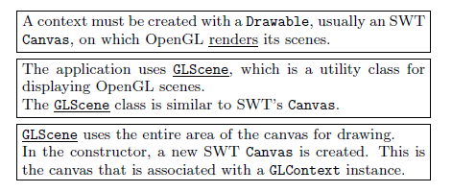
Learning word embedding on software documents
Tutorials, API documents, and bug reports contain sentences that mix natural language with code.
The first sentence creates a context for the natural language word “render” C(render).
3) The next 2 sentences create a context for the code token GLScene C(GLScene).
4) C(render) AND C(GLScene) = SWT, Canvas, OpenGL, scene.
5) The Skip-gram model will automatically create vector representations for the two words that are similar in the same, shared vector space.
6) The number of sentences that mix natural language words with source code tokens is often insufficient for training good vector representations.
7) Since the necessary size of the corpus is proportional with the size of the vocabulary, we reduce the natural language vocabulary by pre-processing the text with the Porter stemmer.
8) This effectively collapses derivationally related words such as draw, draws, drawing, drawable into the same vocabulary entry draw.

Slide 10
Learning word embedding on software documents
Using the same corpus, increase the number of training examples:
Whenever a code token has a name that matches a natural language word, use both the token and the word to create training examples for the logistic regression models.
Apply the logistic regression models on pairs of text and code that are known to have the same meaning or related meanings, such as class-description and method-description in API documentations.

Slide 11
Heuristic Mapping of Tokens to Words
Two vocabularies setting, the word "canvas“ and the token Canvas belong to different vocabularies and therefore are associated different vector representations.
When naming code artifacts such as classes, methods, or variables, natural language words are used that describe the meaning.
When referring to the artifact in natural language, programmers often use the natural language word instead of the code token.
Create additional training by instructing the model to also train for the natural language word "canvas“ whenever it sees an occurrence of the code token Canvas.
For composite token names such as WorkbenchWindow- Splitting based on capitalization and then checking in the natural language vocabulary.

Slide 12
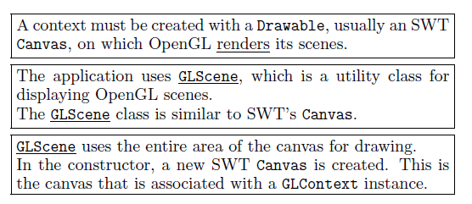
Heuristic Mapping of Tokens to Words
In the figure below, code token Drawable from the context of "render" is mapped to the natural language word "drawable", which has the same stem.

Slide 13
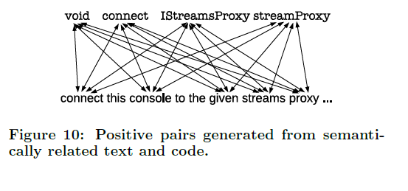
Heuristic Mapping of Tokens to Words
To force the two meaning representations (the bag-of-wordembedding and the bag-of-token-embedding) to be similar, all code tokens from each text word, and all text words from each code token, as shown in Figure below.

Slide 14
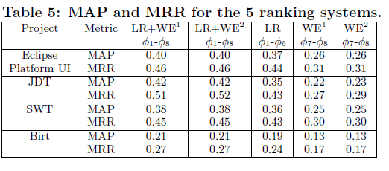
Do word embedding help improve the ranking performance, when added to an existing strong baseline?
.
1. Word-embedding based similarity features, when used as additional features, improve the performance of the LR system.
2. The results of both LR+WE1 and LR+WE2 show that the new features help achieve 8.1%, 20%, 5.6%, and 16.7%.

Slide 15
Thank You!

